Slide 1
Methods for Stochastic Chemical Reactions
Notes:
POINTS:
Identify types of protein regulation – small molecule, protein, covalent
Identify chemical basis of regulation – allosteric, direct, location
Identify how genes are regulated – protein repressors and activators
Networks are complex, modular, robust, and noisy
ODEs won’t suffice in many cases.

Slide 2
Discrete Random Variables

Slide 3
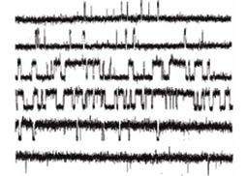
Ion Channel Kinetics
Single channel patch-clamp experiment
X(t) is random variable: X = 0 means channel is closed; X = 1, open
5 μm cAMP
300 μm cAMP
How can you fit this data to a deterministic model?

Slide 4
Discrete Random Variables
X = 0, 1, 2, ….x,
X is a random variable
x is a realization of X; that is, a particular value
(discrete can be nonintegers, but less common)
P(X = x), also written P(x)
Probability mass function
Frequency function
Note that: ∑ P(x) = 1
P(X ≤ x)
Cumulative distribution function

Slide 5
Expectation of Discrete Random Variables
Expectation or mean:
Expectation of a function of a random variable:
Since summation is a linear operator, so is expectation:
However, nonlinear combinations such as second moments:

Slide 6
Variability in Discrete Random Variables
Variance:
Standard Deviation:

Slide 7
Two Random Variables
Expectations:
Variance:
Covariance
Relationship between variation in two variables

Slide 8
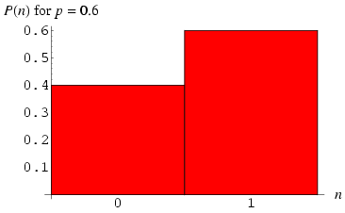
Bernoulli Distribution
Probability mass function, or frequency function
http://mathworld.wolfram.com/

Slide 9
Bernoulli Random Variables
Takes value 0 or 1
Ion channel is open or closed
Coin is heads or tails
A bacteria in my flow chambers is rolling or stationary
Probabilities (note that (0 ≤ p ≤ 1))
P(1) = p
P(0) = 1-p
Expectation: μ = p
Variance = p(1-p)

Slide 10
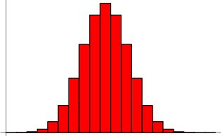
Binomial Distribution
Probability mass function, or frequency function
http://mathworld.wolfram.com/

Slide 11
Binomial Distribution
N Bernoulli trials
N Ion channels; how many are open?
N Coins tossed; how many are heads?
N bacteria in the flow chamber – how many moving?
If we simulate any of these processes, expect the result to be binomial distributed
Probabilities
E(X) = Np
Var(X) = Np(1-p)
Where
is the binomial coefficient

Slide 12
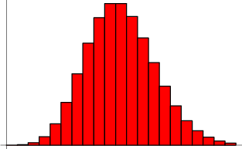
Poisson Distribution
Probability mass function, or frequency function
http://mathworld.wolfram.com/

Slide 13
Poisson Distribution
Poisson distribution is an approximation for the binomial distribution for large N.
as N → ∞ and p → 0
with pN → λ
Probability of k is:
Examples:
How many bacteria, of 10⁹/ml flowing through chamber, bind to the surface?
How many gene delivery vectors bind to the surface of a single cell?
E(X) = Var(X) = λ

Slide 14
Poisson Process
Each event is independent of the others.
For example:
When does next vector bind to the cell?
When is the next radioactive decay?
When does a closed ion channel open, or when does the next ion channel open?
Memory-less:
Doesn’t matter how long ago this channel closed
Many events in Biology can be approximated as Poisson processes

Slide 15
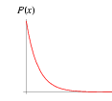
Poisson Process
The time to the next event in a Poisson process is a continuous variable with exponential distribution
The number of events occuring in time T is a discrete variable with poisson distribution.

Slide 16
Stochastic Compartmental Systems: Linear Rate Laws
Linear systems are systems with only unimolecular reactions, or multimolecular reactions in which the concentration of one is held fixed.
How do we analyze such systems?
We can run the simulation many times and calculate statistics from the simulations.
This can be expensive in computer time.
Can we determine analytically what the statistics should look like?
We need a formalism

Slide 17
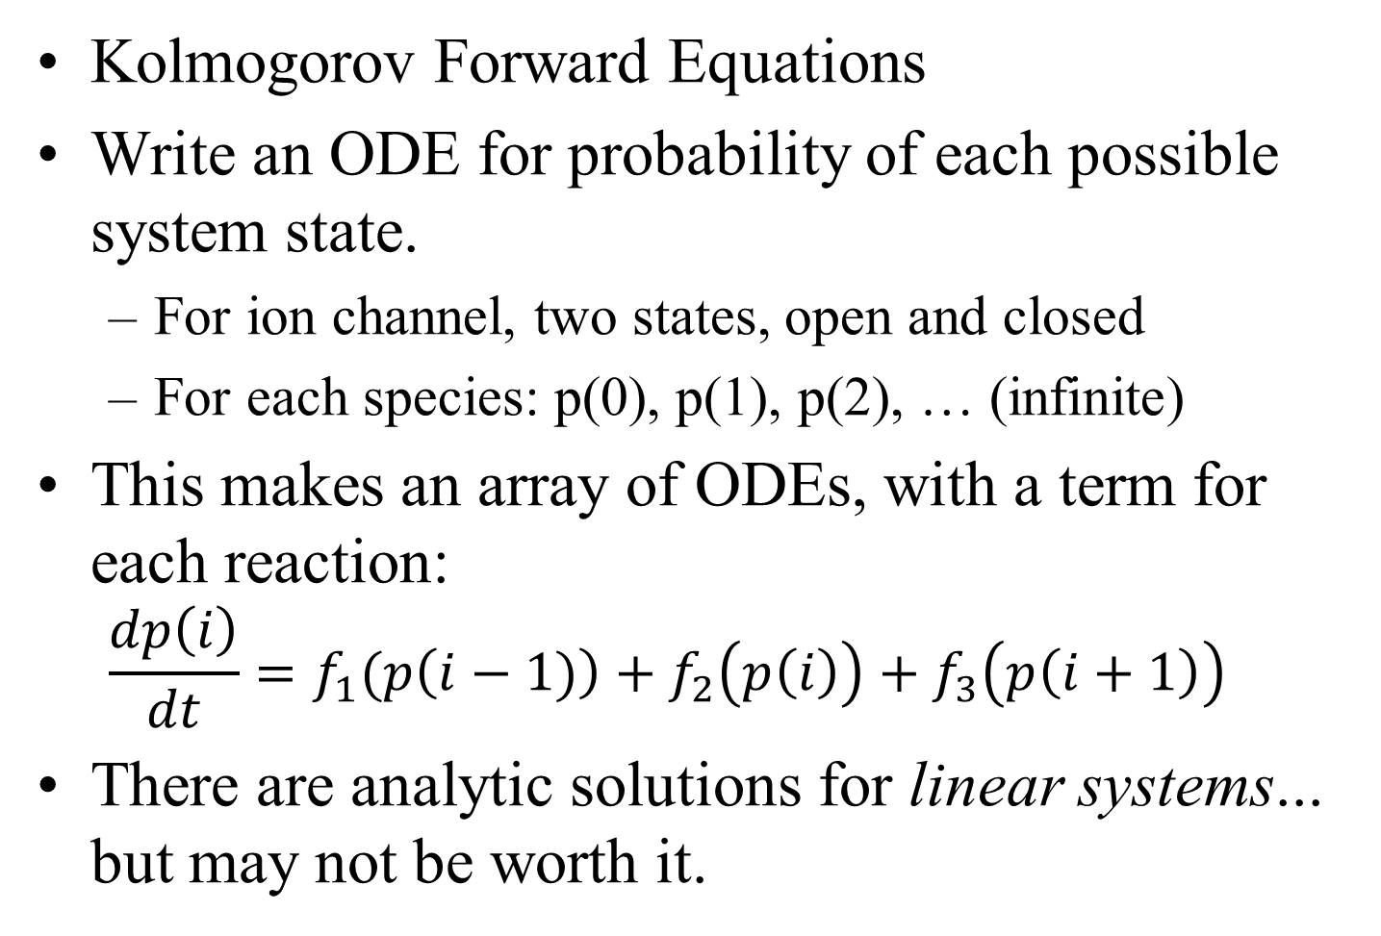
Analytic Solutions
Kolmogorov Forward Equations
Write an ODE for probability of each possible system state.
For ion channel, two states, open and closed
For each species: p(0), p(1), p(2), … (infinite)
This makes an array of ODEs, with a term for each reaction:
$$\frac{dp\left(i\right)}{dt}=f_{1}(p\left(i−1)\right)+f_{2}\left(p\left(i\right)\right)+f_{3}\left(p\left(i+1\right)\right)$$
There are analytic solutions for linear systems... but may not be worth it.

Slide 18
Numeric solutions:
Only method available for most nonlinear problems, such as those including biomolecular chemical reactions
Easier to implement than analytic solutions
A single run is stochastic
Have to run many times to get statistics on the solutions.
Determine mean and variance in this way.
Efficiency is thus very important.
We will look at several methods.
In what conditions does each provide accurate results?
How efficient is each?

Slide 19
Analyzing Stochastic Simulations
Each run of the stochastic simulation is different.
This is why we are concerned with statistics.
What is the mean?
What is the standard deviation?
How are the variables correlated?

Slide 20
Example of Statistics:
black:
analytic solution
μ + σ
blue:
100 runs
μ
magenta:
10 runs
μ – σ
green:
1 run

Slide 21
Ways to Simulate a Poisson Process:
Match time step to next event (1 event)
“Exact” algorithm
Always accurate, but expensive for “big” systems (large numbers)
Gillespie 1977, and previous works
Take medium time steps (0 to ~20 events)
“Tau-leap” algorithm
less expensive for big systems and reasonably accurate if system doesn’t change in a time step (so if time step is well chosen);
Take large time steps (> 10 events)
Gillespie’s “Chemical Langevin Equation” algorithm
Accurate if system doesn’t change in a time step, but > 10 events occur. Least expensive for big systems.
Gillespie in 2000 (J Chem Phus v. 113, p. 297)

Slide 22
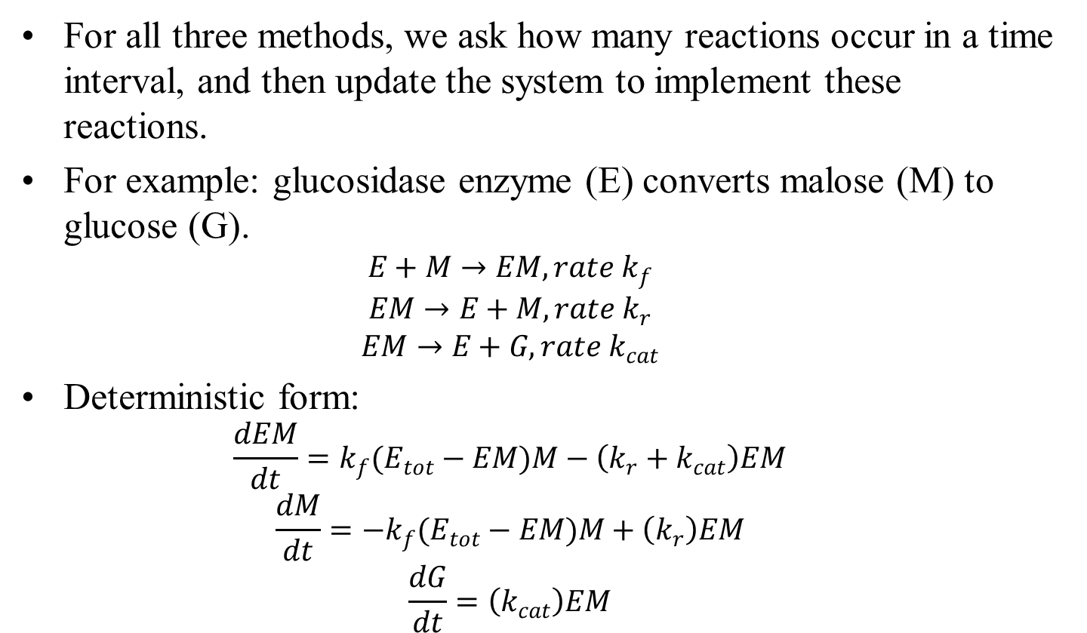
Chemical Reaction Equations
For all three methods, we ask how many reactions occur in a time interval, and then update the system to implement these reactions.
For example: glucosidase enzyme (E) converts malose (M) to glucose (G).
$$E+M→EM, rate k_{f}$$
$$EM→E+M, rate k_{r}$$
$$EM→E+G, rate k_{cat}$$
Deterministic form:
$$\frac{dEM}{dt}=k_{f}(E_{tot}−EM)M−\left(k_{r}+k_{cat}\right)EM$$
$$\frac{dM}{dt}=−k_{f}(E_{tot}−EM)M+\left(k_{r}\right)EM$$
$$\frac{dG}{dt}=\left(k_{cat}\right)EM$$

Slide 23
Reaction-Based Solving Methods:
In stochastic systems the actual “events” or “reactions” is stochastic.
When reaction occurs, it affects many “chemicals” at once.
So uncertainty in these chemicals is coupled.
Thus, we need to organize algorithms on the number and type of reactions that occur, not on the change in each chemical, as we are used to.

Slide 24
Wendy’s Unified Formalism:
Reactions
R is for reactions with r as the index.
(always presented as different rows in matrices)
Chemicals
C is for chemicals with c as the index
(always presented as different columns in matrices)
S is for substrates (left side of equation)
P is for products (right of equation)
E+S→ ES E + S → E + P
ES → E + P
k is for the rate constants for each reaction
k(r) or k_{r} is the rate constant for the r^{th} reaction.

Slide 25
Define System:
Define R reactions according to stoichiometry using two matrices and a column vector:
Matrix S is the substrates.
Matrix P is the products.
Vector K is the reaction rates.
Example:
S₁ + S₂ → S₃ with rate constant k₁
S₁ + S₁ → S₂ with rate constant k₂,
S = [1, 1, 0; P = [0, 0, 1; K = [k1
2, 0, 0]; 0, 1, 0]; k2];
Initial conditions: X(0) for C chemicals: [X₁, X₂, …X_{C}]

Slide 26
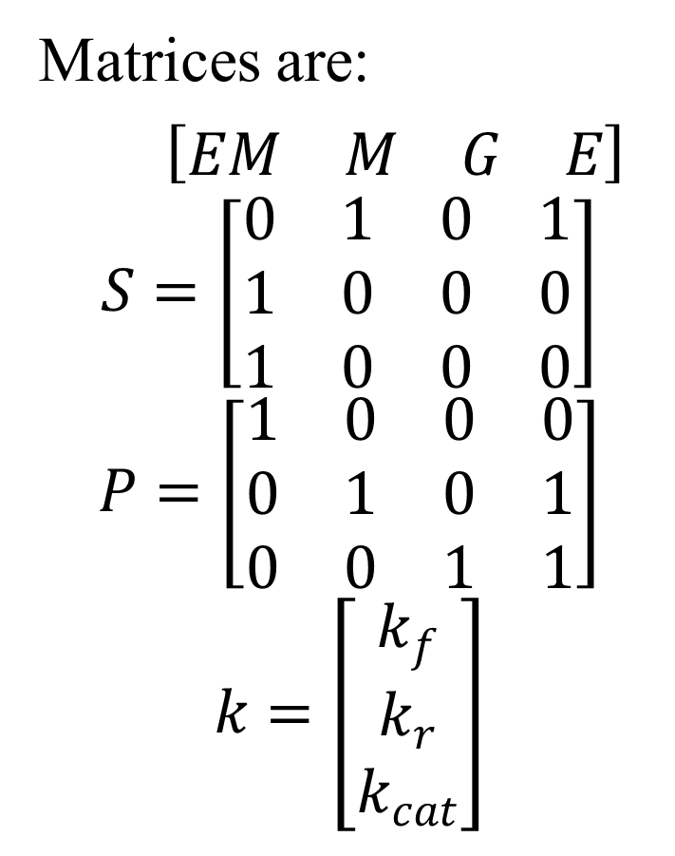
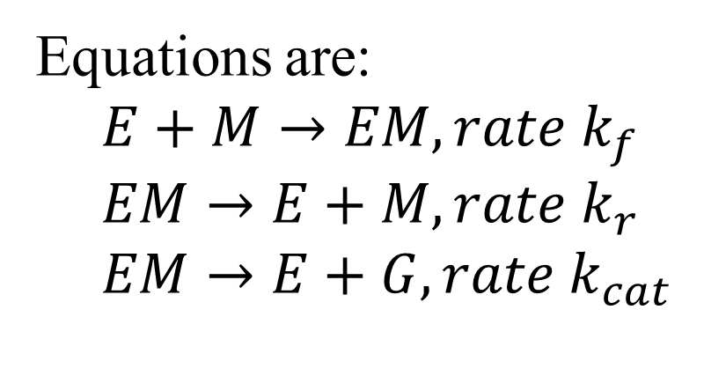
Example 2:
Matrices are:
$\left[\begin{matrix}EM & M & G & E\end{matrix}\right]$
$$S=\left[\begin{matrix}0 & 1 & 0 & 1 \\ 1 & 0 & 0 & 0 \\ 1 & 0 & 0 & 0\end{matrix}\right]$$
$$P=\left[\begin{matrix}1 & 0 & 0 & 0 \\ 0 & 1 & 0 & 1 \\ 0 & 0 & 1 & 1\end{matrix}\right]$$
$$k=\left[\begin{matrix}k_{f} \\ k_{r} \\ k_{cat}\end{matrix}\right]$$
Equations are:
$$E+M→EM, rate k_{f}$$
$$EM→E+M, rate k_{r}$$
$$EM→E+G, rate k_{cat}$$

Slide 27
Gillespie Algorithm Stochastic Simulation Alogorithm
Exact Algorithm to solve chemical reactions
Essentially mimics real situation:
Given rates and molecule numbers,
How long until next change occurs?
Which is next event that occurs?
Elegant and simple. Proposed in 1977
Still used today.

Slide 28
Step 1: Given the system state, determine the rate of each reaction, a_{r}.
Reaction 1: S₁ + S₂ → S₃, with rate constant k₁
X₁, X₂ are the numbers of the reactant molecules
Define the stoichiometry: h₁ = X₁X₂ ; this will give dependence on amounts of molecules.
Then a₁= h₁k₁= k₁ X₁X₂ = rate for this reaction.
Reaction 2: S₁ + S₁ → S₂,
h₂ = X₁(X₁-1)/2 (why is this true?)
Finally, define: a₀ = Σa_{r} (r = 1 to R)
This is the combined rate of all possible reactions

Slide 29
Gillespie Rates:
What is the residence time of this state?
How fast do we leave this state?
a₁
a_{R}
x₁, x₂, ..x_{C}
a_{R-1}
a₂
a₀ = Σa_{r}
(r = 1 to R)
is the total rate at which some reaction occurs.
a_{r}

Slide 30
What is the residence time of this state?
Probability p that state still survives at time τ:
Simple Poisson Process
Current state
x₁, x₂, ..x_{R}
Exponential decay
Thus:
a₀
All other states
As p decays from 1 to 0, τ increases from 0 to infinity

Slide 31
Step 2 When does the next reaction occur …
Pick p, a uniform random number from 0 to 1
Let
This is time of the next event.
(Note that the time step doesn’t have to be predetermined, and is exact.)

Slide 32
Step 2 …and which reaction is it?
Determine which reaction occurs at time τ:
Pick p₂, another uniform random number from 0 to 1
Find r, such that:
Think about dividing a₀ into R pieces of length a_{r}
p₂ determines r based on weighting:
p₂a₀
a₁
a₂
a₃
a₄

Slide 33
Step 3 Update the System State
Update t = t + τ
Update X = [X₁, X₂, …X_{C}] according to the reaction stoichiometry
Subtract substrates and add products for the indicated rth reaction.
For each c, X_{c} = X_{c} – S(r,c) + P(r,c)
In matrix format:
X(end+1,:) = X(end,:) – S(r,:) + P(r,:)
Update reaction step counter (RC = RC+1).
Step 3 is to determine how each of C chemicals are affected

Slide 34
Questions?
Why is (on average) the time to the next step the same, whether the actual event has a slow or fast rate?
Example: student state change in class.

Slide 35
Collecting Data From Exact
The algorithm writes out [X₁, X₂, …X_{C}, t] at each time step.
But all the runs will encounter different time steps, and likely more than you need!
Make a time vector:
time = linspace(0,totalTime,100);
After each run, calculate data at periodic intervals with interp1:
Y(1,:)= interp1(t,X(1,:),time,'nearest');
Calculate mean values and variance just like previous examples

Slide 36
Advantages of Exact
Exact simulation; Makes no approximations
No need to predetermine time steps
Time step responds to changes in rates as numbers of particles change.
No conditions: always is accurate.

Slide 37
Disadvantages of Exact
Gets very slow when any one reaction is very fast relative to others. (stiff systems)
Fast reaction occurs with fast rates or if there are a lot of a reactant.
Thus, can be ineffective even though it is accurate in theory.
Tau-leap algorithm deals with these situations

Slide 38
Tau-leap method
Explained in Higham 2007 article, page 12
When using the exact stochastic algorithm, time for next reaction is determined.
When there are lots of some type of chemical, you don’t need to take so few steps for reactions involving this chemical, since your system doesn’t change much anyway.
Tau-leap:
for a given size of time step,
determine the number of each reaction that occur in that time step using the Poisson distribution
update all reactions simultaneously
Assumes: system (rates) doesn’t change much in one time step (like all ODEs).

Slide 39
Expected Number of Events:
Like Gillespie:
The rate that each reaction r occurs is a_{r}
It is calculated the exact same way.
Unlike Gillespie:
For each r, ask: how many reactions will take place in time Δt?
Expected value is λ_{r} = a_{r} Δt.
Recall: Poisson distribution: what is the probability of getting n when the expected value is λ?
(Why don’t we use the binomial distribution to make sure we don’t use up a reagent?)

Slide 40
Algorithm for actual number of events:
From last slide, have calculated the expected value λ
Pick r, a random number between 0 and 1, uniform distribution.
Psum = 0
In a loop starting at n = 0
Calculate P(n) given λ_{r} from
Psum = Psum + P(n)
if r < Psum, then n_{r} = n; exit loop
n gives how many of this reaction occurs.
Do this for each reaction!
I have written a function, n = randp(lambda), that does just this. It is called by the TauLeapWendy algorithm.

Slide 41
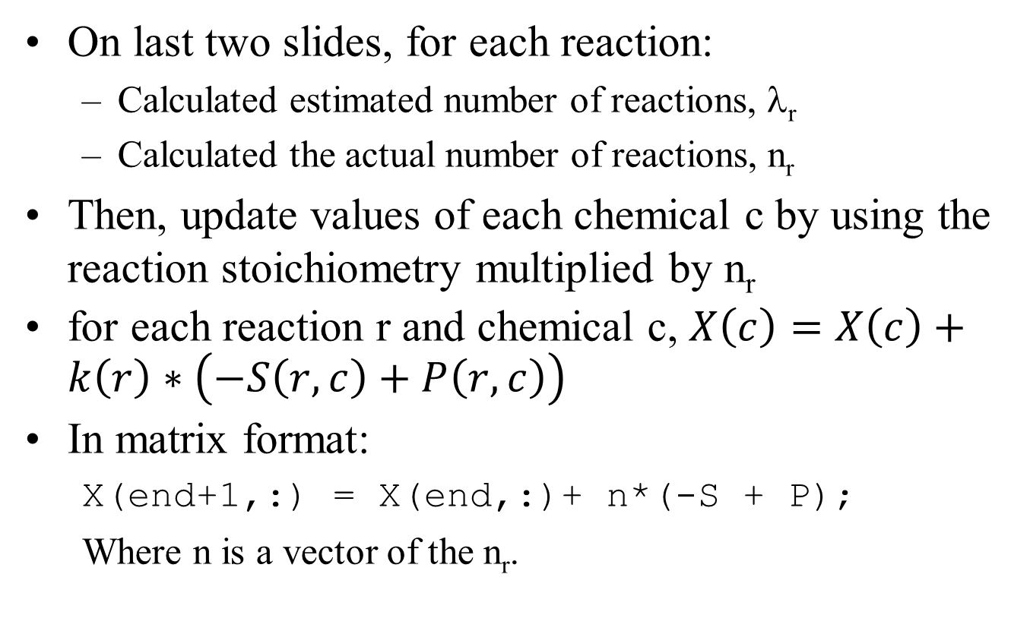
Update the System State:
On last two slides, for each reaction:
Calculated estimated number of reactions, λ_{r}
Calculated the actual number of reactions, n_{r}
Then, update values of each chemical c by using the reaction stoichiometry multiplied by n_{r}
for each reaction r and chemical c, $X\left(c\right)=X\left(c\right)+k\left(r\right)∗\left(−S\left(r,c\right)+P\left(r,c\right)\right)$
In matrix format:
X(end+1,:) = X(end,:)+ n*(-S + P);
Where n is a vector of the n_{r}.

Slide 42
How to Determine the Time Step?
Choice 1: fix the time step throughout the simulation (easy, but inaccurate and/or inefficient)
Choice 2: adjustable time step depends on system state (accurate and efficient)
To do this, want largest time step that isn’t expected to change the system state.
Must decide this BEFORE finding the random numbers
Otherwise, will bias towards smaller changes
Thus must use the EXPECTED fractional change
Change = lambda*(-S + P);
Current = X(end,:)
Consider: Max(abs(change./current))
If > RelTol, make step smaller.
Some mechanism to increase step

Slide 43
Chemical Langevin Equations (CLE)
A way to simulate chemical reactions where numbers of elements are
large enough to use continuous model,
but small enough to consider stochastic process
Name and method are motivated by the Langevin Equation for diffusion.

Slide 44
Poisson Random Process
Recall that a Poisson distribution is:
How many events occur in time Δt?
Expected value is:
Variance = mean, so
The CENTRAL LIMIT THEOREM states
The sum of a sufficiently large number of independent random variables of identical distribution (like the bournoulli distribution) has an approximately normal distribution
Thus, if a₁Δt > ~10, can use:
P(k) = N(a₁Δt, a₁Δt)
Read: normal distributed with mean a₁Δt and variance a₁Δt.
a₁ is reaction rate

Slide 45
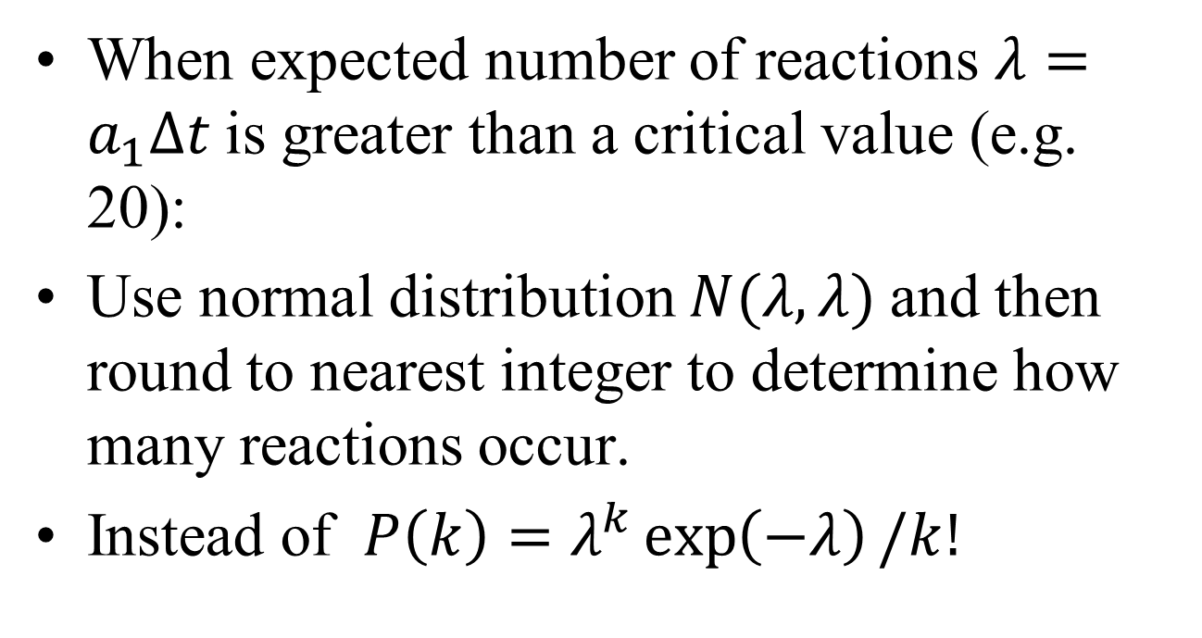
Wendy Formalism
When expected number of reactions $λ=a_{1}Δt$is greater than a critical value (e.g. 20):
Use normal distribution $N(λ,λ)$and then round to nearest integer to determine how many reactions occur.
Instead of $P\left(k\right)=λ^{k}\exp\left(−λ\right)/k!$

Slide 46
Exact
Step 0: set up S,P,K
Step 1: Calculate
a_{r}
a₀ =sum(a_{r})
Step 2: Use 2 random numbers to pick when the next occurs and which reaction it is.
Step 3: update system for the one reaction only
Tau-leap/CLE
Step 0: set up S,P,K
Step 1: Calculate
a_{r}
λ_{r} = a_{r}Δt
(adjust time step until OK)
Step 2: use R random numbers to determine number of events, n_{r} , for each reaction.
Step 3: update system for all R reactions

Slide 47
Conditions for tau-leap/CLE
Condition: Require Δt to be small enough that so the system doesn’t change appreciably during that step (same as any deterministic ODE solver)

Slide 48
Normally Distributed Random Variables in MATLAB
r=randn;
Gives normally distributed random variable with mean 0 and standard deviation 1.
r=mu+simga*randn;
Gives normally distributed random variable with mean mu and standard deviation sigma.

Slide 49
Concentrations vs Numbers
Note that a_{μ}(x_{t})Δt is how much the system would change in a deterministic equation due to the reaction μ.
We work in numbers and not concentrations because the noise depends on number, not standard deviations.
But second-order rate constants still require a concentration so volume also must be known. If volume is constant, this can be incorporated into cμ.

Slide 50
Gillespie exact, tau-leap, Chemical Langevan Summary
All are reaction based, so can use the same formalism.
All have the same issues and solutions for concentrations vs numbers.
Exact Algorithm is most reliable and is also most efficient when there are not too many reactions. Thus it should be tried first.
Tau-Leap/CLE combined is most efficient when there are large numbers of reactions, and should be tried if Exact is too expensive.

Slide 51
Wendy’s Stochastic Simulation Software Suite
Posted on her lab web site with examples: https://faculty.washington.edu/wendyt/software.html
Written like the ODE solvers; two solvers (exact and Tau-leap), that call the equations you write.
You write the equations using the reaction formalism (S, P, K), instead of the derivative equations as for ODEs.

Slide 52
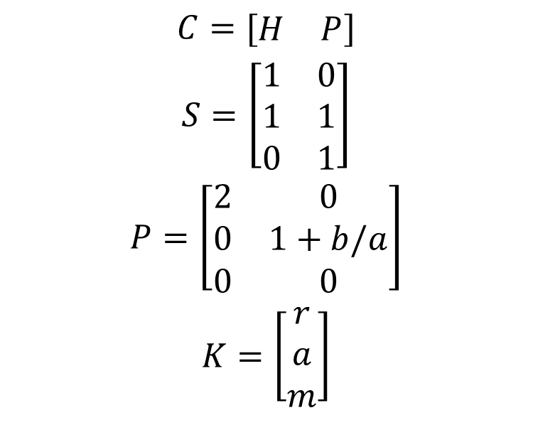
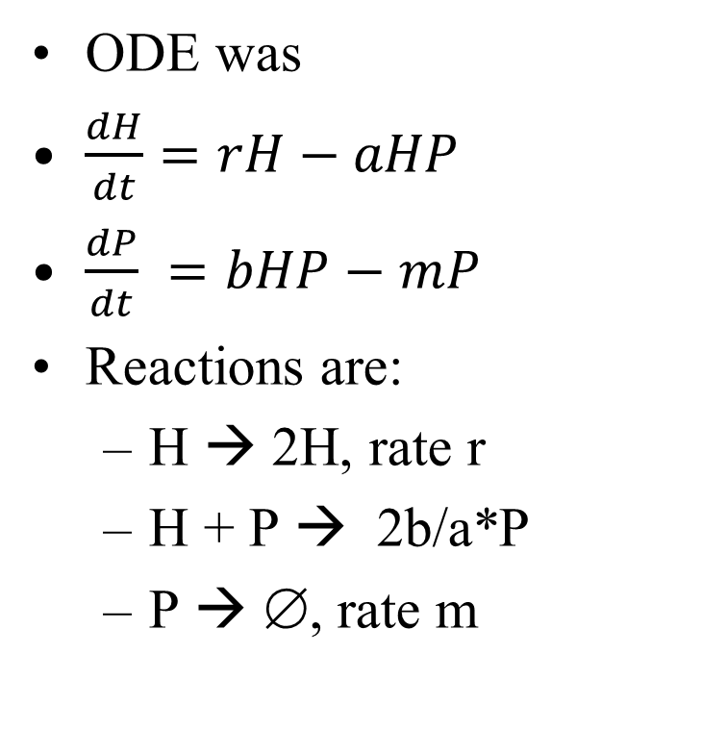
Lotka Example
ODE was
$\frac{dH}{dt}=rH−aHP$
$\frac{dP}{dt} =bHP−mP$
Reactions are:
H → 2H, rate r
H + P → 2b/a*P
P → ∅, rate m
$$C=[\begin{matrix}H & P\end{matrix}]$$
$$S=\left[\begin{matrix}1 & 0 \\ 1 & 1 \\ 0 & 1\end{matrix}\right]$$
$$P=\left[\begin{matrix}2 & 0 \\ 0 & 1+b/a \\ 0 & 0\end{matrix}\right]$$
$$K=\left[\begin{matrix}r \\ a \\ m\end{matrix}\right]$$

Slide 53

Lotka Example
$$C=[\begin{matrix}H & P\end{matrix}]$$
$$S=\left[\begin{matrix}1 & 0 \\ 1 & 1 \\ 0 & 1\end{matrix}\right]$$
$$P=\left[\begin{matrix}2 & 0 \\ 0 & 1+b/a \\ 0 & 0\end{matrix}\right]$$
$$K=\left[\begin{matrix}r \\ a \\ m\end{matrix}\right]$$
Reactions are:
H → 2H, rate r
H + P → 2b/a*P
P → ∅, rate m
Code:
IC=[H0 P0]; tspan = [0,20]; par =[r,a,b,m];
[t,y]=DSDEexact(@LotkaRXN,tspan,IC,par);
Equations being called:
function [S, P, K] = LotkaRXN(params)
r=par(1); a=par(2); b=par(3); m=par(4);
S=[1 0;1 1;0 1] ;
P=[2 0;0 2*b/a;0 0]; K = [r a m];

Slide 54
Determinstic Lotka

Slide 55
Discrete Stochastic Simulation
P stochastic
P deterministic
H deterministic
H stochastic
Neutrally stable steady state solution for deterministic system unstable in stochastic system.

Slide 56
Lotka with starting conditions that result in continuous oscillations:
Cycles shift in value and in time interval
P stochastic
H stochastic
P deterministic
H deterministic
H becomes extinct! (Then P does too.)
Time
Random fluctuations can cause big changes

Slide 57
Average of 30 Lotka
Stochastic system shows extinction as stable steady state that did not arise as an issue in stochastic.

Slide 58
Phase Plane of Lotka:
Stochastic deterministic
No longer repeats same cycle; instead, diffuses between nearby cycles.
P
H
H

Slide 59
Neutral Equilibrium Point
The fluctuations cause jumps between the cycles
The model will “diffuse” away from a neutral equilibrium point, or from any cycle.
Why does it tend toward wider and wider sweeps?

